Slide 1
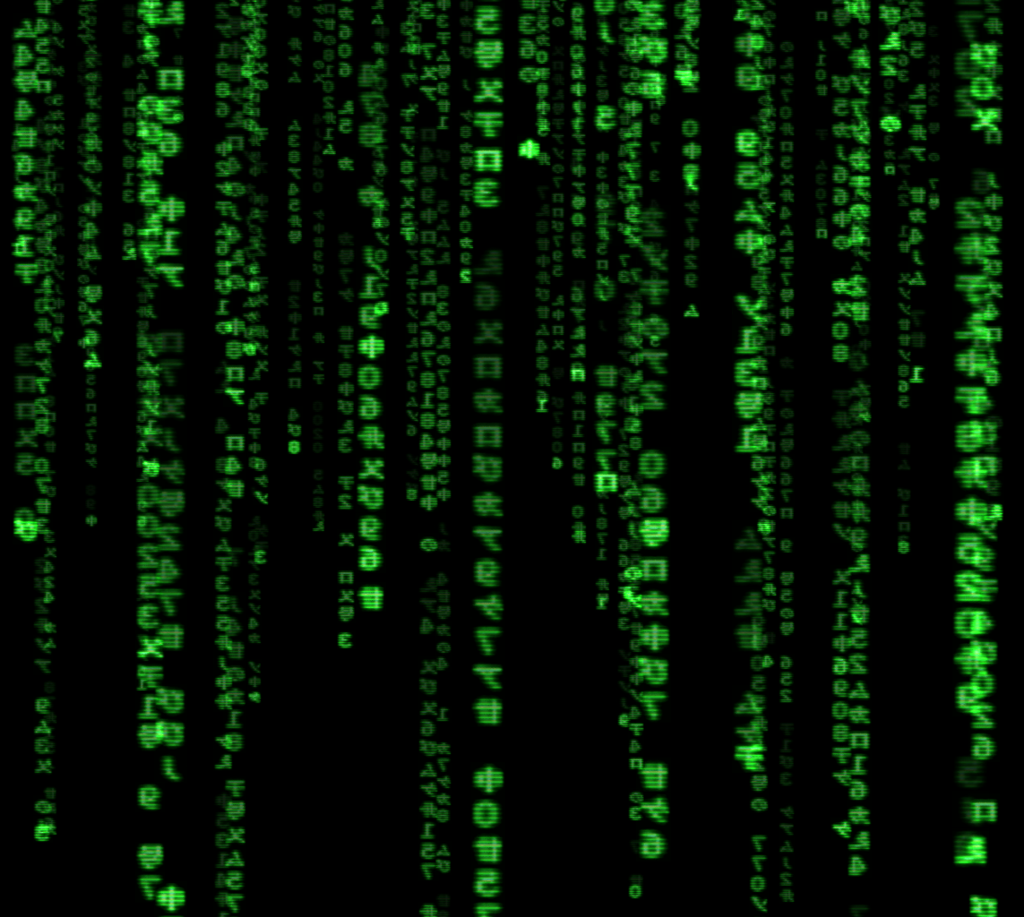
Python101
Programming with Python
Ozan Polatbilek
1

Slide 2
Algoritma Nedir?
Algoritma, bir işin yapılışını detaylı olarak anlatan komutlar bütünüdür.
Sözel olarak gösterilebileceği gibi çeşitli sembollerle de gösterilebilir.
Örn. Sabah Rutini
Diş Fırçala
Dışarı bak
Eğer hava yağışlıysa
Bot, atkı, bere, kazak, pantolon giy.
Eğer hava güneşliyse
Spor Ayakkabı, tshirt, şort giy.
Kahvaltı yap
Evden çık
2

Slide 3
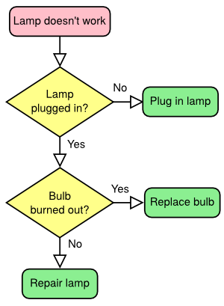
Algoritma Nedir?
3

Slide 4
Program ve Programlama Dilleri
Program: Bir bilgisayarda çalışabilecek, çeşitli işler yapmaya adanmış iş veya iş kümeleri.
Windows, Chrome, Dota, PowerPoint, Spyder… vb.
Programlama Dili: Bilgisayara bir programın neler yapacağını ve nasıl yapacağını anlattığımız komutlar bütünü. Oluşturduğumuz algoritmaları bilgisayarın anlayacağı dile dönüştüren araç.
Python, C, Matlab, Java, Fortran, PHP … vb.
4

Slide 5
Programların Çalışma Prensipleri
Compiled Languages
Kod önceden compile edilir, oluşan byte-code çeşitli inputlarla çalıştırılır,
Deployment isteyen (örn. Web) sistemlerde can sıkıcı olabilir,
Interpreted dillerden daha hızlıdır, genelde sisteme erişim varsa mutlaka tercih edilmelidir.
C, C++, C#, Java, … vb.
5

Slide 6
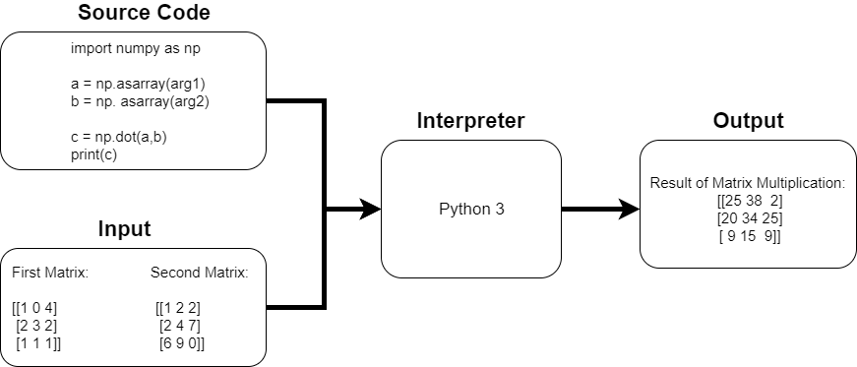
Programların Çalışma Prensipleri
Interpreted Languages
Yazılan kod, input ile beraber bir interpreter aracılığıyla byte-code’a dönüşür,
Aktif olan kod parçası çalıştırılır, yani koddaki bir hata o bölüm çalışana kadar görülmez.
Web servisleri için daha idealdir, sisteme erişim isteyen sistemler için tercih edilmemelidir.
Python, PHP, JavaScript, Scheme … vb.
6

Slide 7
IDE - Interpreter
IDE is an editor to write more elegant codes.
IDE controls how you wrote the code, is it OK with syntax rules and help you on coding.
IDE checks the source code and if it is OK for it, sends it to interpreter.
Interpreter only takes source code and input and runs.
Spyder is an IDE, Python3 is the interpreter (and the language, same name). So you can code without spyder, or with any other IDE (e.g. Pycharm, sublime…etc)
7

Slide 8

Problem #1
Write a program to calculate the sum of the numbers from 1 to 10
8

Slide 9
Problem #2
Write a program to swap the values of 2 variables
E.g.
İf:
number1 = 2
number2 = 3
When we print variables after your swap:
print(number1)
print(number2)
We should see:
3
2
9

Slide 10
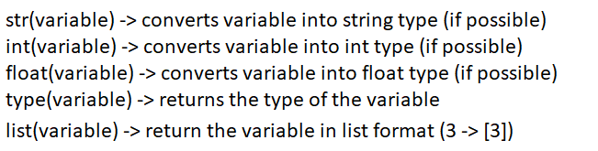
Data Types
There are multiple data types in Python. But the most important ones:
integer (int), string (str), float, list
a = ‘3’ < - - string (str)
b = 3 < - - integer (int)
c = 3.14 < - - float
var = ‘python’ < - - string(str)
var_list = [2, 3, 1, 0.2, 0] < - - list
You must treat the variables as which type they are. (e.g. You can’t multiply string with integer)
You can convert one type to another (if possible)
d = a + b However you can do -> d = int(a) + b (where d becomes 6 as integer)
e = b +c This is valid operation since integer can be converted into float (3 = 3.0) and e= 6.14 as float
f = int(var) There is no integer value of string ‘python’
g = var_list[0] (then value of g is 2 as integer), g = var_list[3] (then value of g is 0.2 as float)
10

Slide 11
Input - Output
print() is our output function. It prints the string written in it or string format of the input given to it.
input() is our input function. It prints the string which is written in it, and takes the input as string always. If you need integer or any other type, you need to cast it using :
int(input(‘Input please: ’))
11

Slide 12
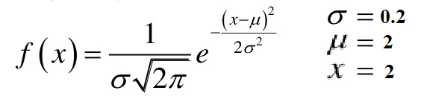
Problem #3
Write a program to calculate normal function value with given parameters below
12

Slide 13
Problem #4
Write a program to multiply 2 matrices (3x3 matrices) Matrices will be named as A and B and the outpur matrix should be named as C All matrices should be stored as list of lists (2-dimension) but the multiplications can be done one by one
13

Slide 14
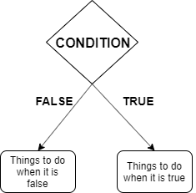
İf/else Statements
‘if’ and ‘else’ are used in conditional situations. E.g.
if temperature>0: if condition == True:
Water doesn’t freze things to do when true
else: else:
Water freze things to do when false
14

Slide 15
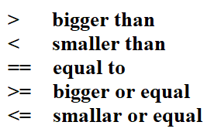
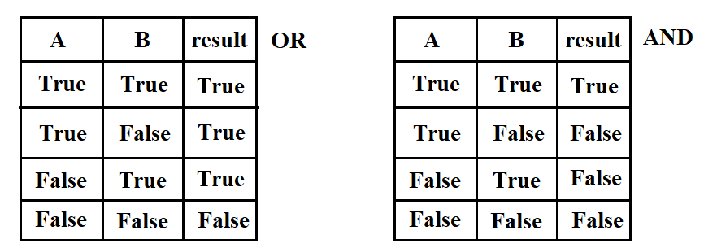
İf/else Statements
Usage:
if ‘condition’:
Codes to execute when condition true
else:
Codes to execute when condition false
15

Slide 16
Problem #5
Please write a code which finds whether a year is a leap year (artık yıl).
To be a leap year:
The year should be evenly divided by 4;
If the year can be evenly divided by 100, it is NOT a leap year, unless;
The year is also evenly divisible by 400. Then it is a leap year.
You can create a variable named as year which holds a year (e.g. year = 2001)
16

Slide 17
Problem #6
Please write a code to give letter grade to the grade of student
Teach uses the formula given below for adjusting the numerical grade:
grade = 10√x where x is actual grade
And for letter grade
>90 is AA
85-90 BA
80-85 BB
75-80 CB
And goes like this until ff, below ff every grade is ff.
17

Slide 18
Loops (for loop)
They are used when we need to do things repeatedly.
Syntax:
for var_name in range(number): or for var_name in list_name:
You need to put indent (press tab) to write code under a loop.
Anything written under for with indent belongs to for and will be executed repeatedly.
for loop is generally used for scanning the whole list or doing things certain times.
18

Slide 19
Loops (while loop)
They are used when we need to do things repeatedly.
Syntax:
while condition: (it truns while the condition is true) (conditions are like in if/else)
You need to put indent (press tab) to write code under a loop.
Anything written under for with indent belongs to for and will be executed repeatedly.
while loops are generally used for doing things repeatedly while condition holds.

Slide 20
Problem #7
Write a program to find the maximum value in the given list and print the index of it:
List1 = [0, -1, 3, 5, 10, 2, 1, 7]
The program should print 4

Slide 21
Problem #8
Write a program to calculate the fibonacci numbers until user’s specified index
Fibonacci numbers are the numbers which are sum of previous 2 numbers. (numbers start with 0 and 1)
Fibonacci numbers:
0, 1, 1, 2, 3, 5, 8, 13, 21 ….
Take input from user how many fibonacci number to print, then print.
For example:
User enters 5:
Your program should print:
0, 1, 1, 2, 3
İf user enters 8
0, 1, 1, 2, 3, 5, 8, 13

Slide 22
Problem #9
Write a program to draw chistmas tree. The program takes input from user the number of layers of the tree, then draws the tree. Examples:
User input: 3 * *** *****
User input: 5
* *** ***** ******* *********

Slide 23
Problem #10
Write a program to perform matrix multiplication for any given matrix (not just 3x3) if matrix multiplication can be perform (matrices should in the form of mxn , nxk). You can use loops (and please use it).
Write a program to sort a given list of numbers in ascending order (in index 0 there should be the smallest and the biggest should be at the end of the list.) You can’t use any additional list (or create any list) other than the list given to you. You can create a list named as numbers to store numbers in shuffled order and cannot create any other list than numbers list

Slide 24
Functions
Functions are group of code that are designed to perform a task.
They are created to reduce code redundancy.
Functions may or may not take argument.
Functions may or may not return a value.
Each function finished when it is terminated, the code wait for it to finish its job.
Any function which is not called, cannot be executed.
Functions should be declared in the script or they can be created in other script and imported.

Slide 25
Problem #11
Write program which takes 2 inputs from user. One is current hour written in format hh:mm:ss and how many seconds to add to it and print the added value. However you should create 3 functions one calculates the ‘second’ part, the other calculated ‘minutes’ part, last one calculates ‘hour’ part.

Slide 26
Problem #12
Write a function which takes a string and returns True if the string is palindrome, False otherwise.
Palindrome examples:
‘mom’
‘Rotator’
‘Madam’
‘level’

Slide 27
Problem #13
Write a function to sort given list and return the sorted list. You should create swap function to perform swap, find min function to find the index of min value. You can use bubble sort which is shown previously.

Slide 28
Problem #14
Write a program which creates a menu like below: 0) Exit 1) Add
2) Delete
3) Show
4) PrintAll
And if user enters 1, then it takes a number and adds it to a list if user enters 2, then program takes index to delete the element from list if user enters 3, then program takes index to show the value in that index if user enters 4, then program prints whole list if user enters 0, program exits. Advanced problem: Make the program uncrasheble (if i enter string as input rather than integer program could crash) and user friendly (a welcoming print a goodbye print in option 0 etc.)

